Slide 1
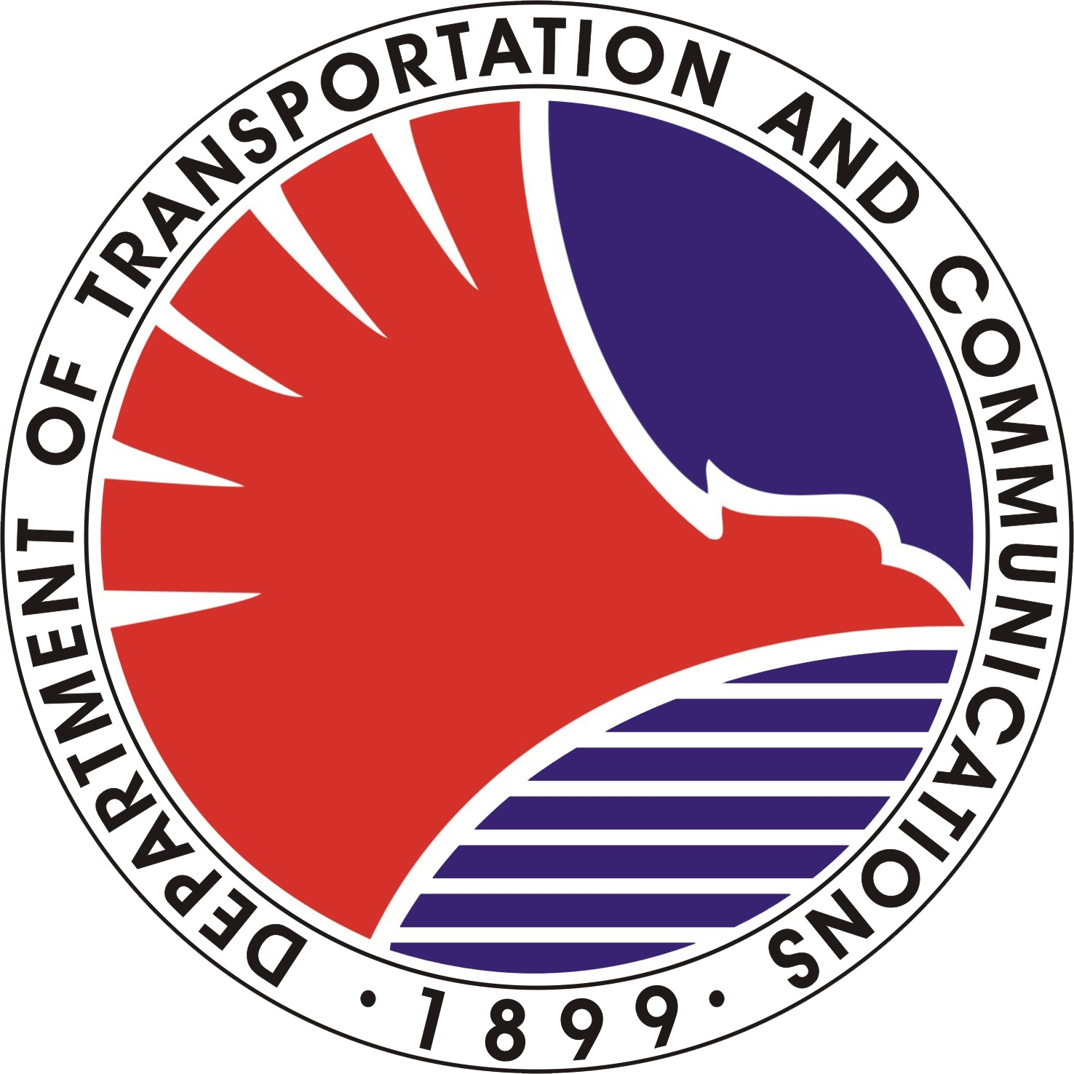
REPUBLIC OF THE PHILIPPINES
Department of Transportation and Communications
Metro Rail Transit 3 (DOTC - MRT3)
This certificate is issued to
for having completed the training for
Ticket Seller II
conducted by the Support Staff/Computer Section/AFC Center
on August 01 - 31, 2012
Given this 5th day of August 2013
at the
North Triangle Area, Quezon City
ROGELYN GURADILLO

